Slide 1
Starting eBox...

Slide 2
eBox
Copyright © 2014-2017 eBox Corporation.
Copyright © 2009-2017 BubbleSoft & PC.
The best Virtual Machine Manager.

Slide 3
Booting BubbleSoft Windows Codename Bobcat...

Slide 5

BubbleSoft© Bindows© Code Name
Bobcat

Slide 7
BubbleSoft Bindows Codenamed “Bobcat”
Official version. Build 4076

Slide 8

Please wait while Bobcat start up.

Slide 9
CTRL+ALT+SUPR
Please, Press CTRL+ALT+SUPR to get started.

Slide 10
Administrator

Slide 11
Logging in…

Slide 12
Starting Group Policy Service…

Slide 13
Waiting for Bobcat Updates Service…

Slide 14
Waiting for .net Server…

Slide 15
Logging in…

Slide 17
BubbleSoft Bindows Codenamed “Bobcat”
Official version. Build 4076

Slide 18


BubbleSoft Bindows Codenamed “Bobcat”
Official version. Build 4076

Slide 19



Support Bobcat
Notes of the
lastest release
of Bobcat
BubbleSoft Bindows Codenamed “Bobcat”
Official version. Build 4076

Slide 20

Administrator
Support Bobcat
Preferences
Customize your computer.
Quick Start
Notes of the
lastest release
of Bobcat
BubbleSoft Bindows Codenamed “Bobcat”
Official version. Build 4076
Turn off computer

Slide 21

System Preferences
X
Preferences
Coming soon more settings!
preferences
Support Bobcat
User Accounts
Notes of the
lastest release
of Bobcat
BubbleSoft Bindows Codenamed “Bobcat”
Official version. Build 4074

Slide 22
User Accounts
X
Support Bobcat
Administrator
Owner
Notes of the
lastest release
of Bobcat
OK
BubbleSoft Bindows Codenamed “Bobcat”
Official version. Build 4074

Slide 23
Notes of the lastest release of Bobcat.
X
Bobcat Build 4074 (under construction)
Features
-New logon screen
-Shutdown timer
-Windows 6 Simplififcation
-”Control Panel” renamed to “Preferences”
-Added Support Bobcat
-WINFS is working in this version
-Added Quick Acess
This is all for now. You can send feedback at Support Bobcat.
Thanks!
-The Bobcat Team
Support Bobcat
Notes of the
lastest release
of Bobcat
BubbleSoft Bindows Codenamed “Bobcat”
Official version. Build 4076

Slide 24

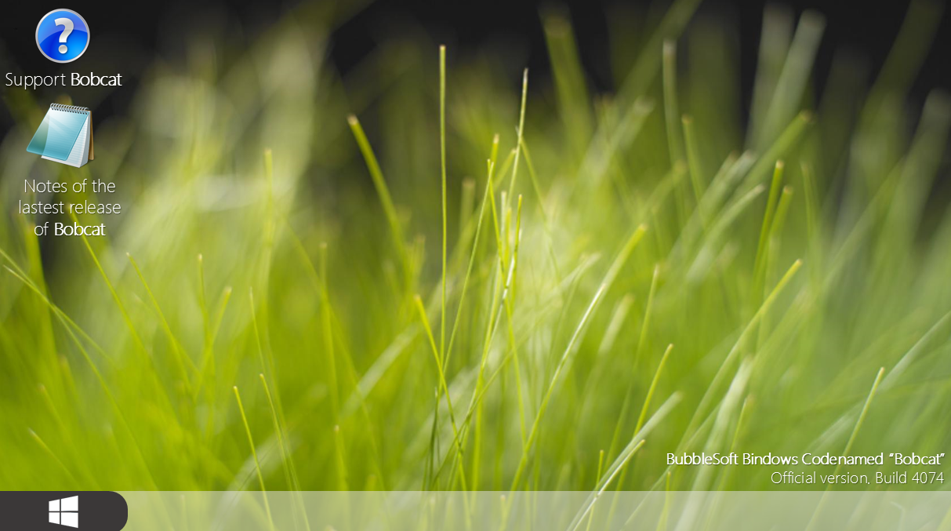
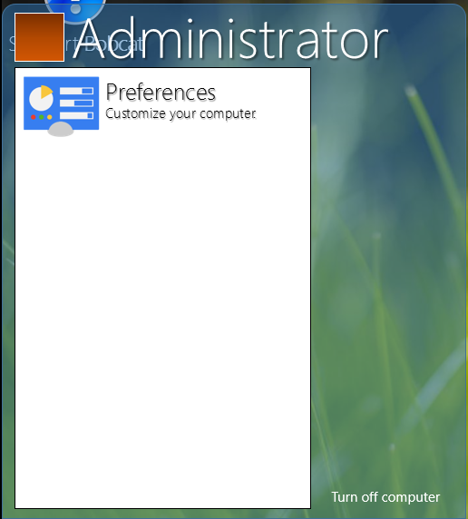
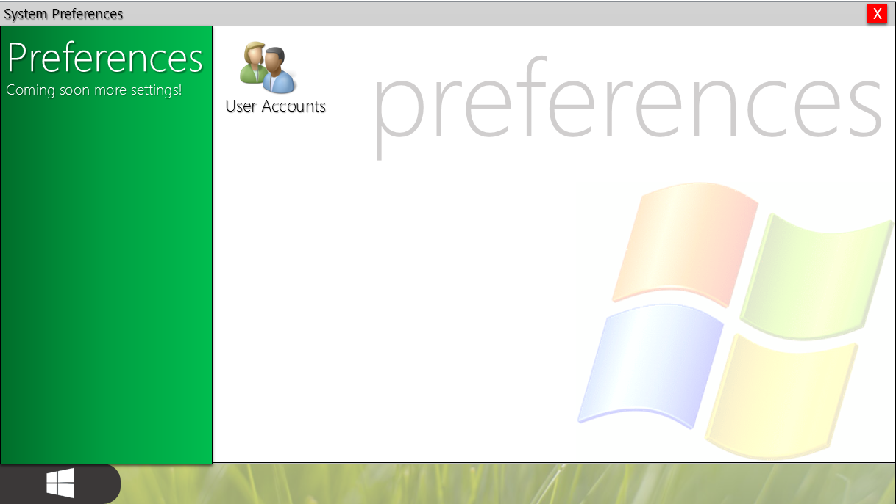
Support Bobcat
X
Welcome to Support Bobcat!
Support Bobcat
You can send feedback to BubbleSoft for Suggestions, SDK, Bugs, Glitches
and criticizes!
Comments?
Notes of the
lastest release
of Bobcat
Nice aero styled start menu. :)
“Control Panel” renamed to
“Preferences”
All of your applications are located on Start Menu.
BubbleSoft Bindows Codenamed “Bobcat”
Official version. Build 4074

Slide 25
Support Bobcat
X
Welcome to Support Bobcat!
Support Bobcat
You can send feedback to BubbleSoft for Suggestions, SDK, Bugs, Glitches
and criticizes!
Send feedback about Bobcat.
OK
X
Tell us what is the problem.
Comments?
Notes of the
lastest release
of Bobcat
Nice aero styled start menu. :)
“Control Panel” renamed to
“Preferences”
All of your applications are located on Start Menu.
BubbleSoft Bindows Codenamed “Bobcat”
Official version. Build 4074

Slide 26
Support Bobcat
X
Welcome to Support Bobcat!
Support Bobcat
You can send feedback to BubbleSoft for Suggestions, SDK, Bugs, Glitches
and criticizes!
Send feedback about Bobcat.
X
Comments?
Notes of the
lastest release
of Bobcat
Nice aero styled start menu. :)
Thanks! We work hard to improve our operating systems.
OK
“Control Panel” renamed to
“Preferences”
All of your applications are located on Start Menu.
BubbleSoft Bindows Codenamed “Bobcat”
Official version. Build 4074

Slide 27
Support Bobcat
A application needs permission to continue
X
Would you like the application makes change in your computer?
Notes of the
lastest release
of Bobcat
Application: QuickStart.bat
Producer: BubbleSoft Corporation
Status: Trust in this application, I’ts signed by BubbleSoft
OK
BubbleSoft Bindows Codenamed “Bobcat”
Official version. Build 4076

Slide 28
Support Bobcat
Please wait…
Quick Start
by BubbleSoft.
Notes of the
lastest release
of Bobcat
BubbleSoft Bindows Codenamed “Bobcat”
Official version. Build 4076

Slide 29
exit quick start
Programs recentely used:
Recent email:
Turn off computer

Slide 30
Support Bobcat
Turn off your computer
X
Notes of the
lastest release
of Bobcat
¿Are you sure if you want to turn off your computer?
Press the “X” to cancel
Turn off
BubbleSoft Bindows Codenamed “Bobcat”
Official version. Build 4076

Slide 31
BubbleSoft Bindows Codenamed “Bobcat”
Official version. Build 4076

Slide 32
Logging off…

Slide 33
Shutting down Group Policy Service…

Slide 34
Waiting for Bobcat Updates Service…

Slide 35
Waiting for .net Server…

Slide 36
Logging off…

Slide 37
Please wait while Bobcat shutdown your computer.

